Slide 1
PORTFOLIO ICDT 1016Y
By Esaie Moos
ID: 2114762

Slide 2
Semester 1
Started extremely intimidated by college and was nervous .
But in the end, I began to really apply myself to my classes and now I feel like I have definitely adjusted well to the college atmosphere.

Slide 3
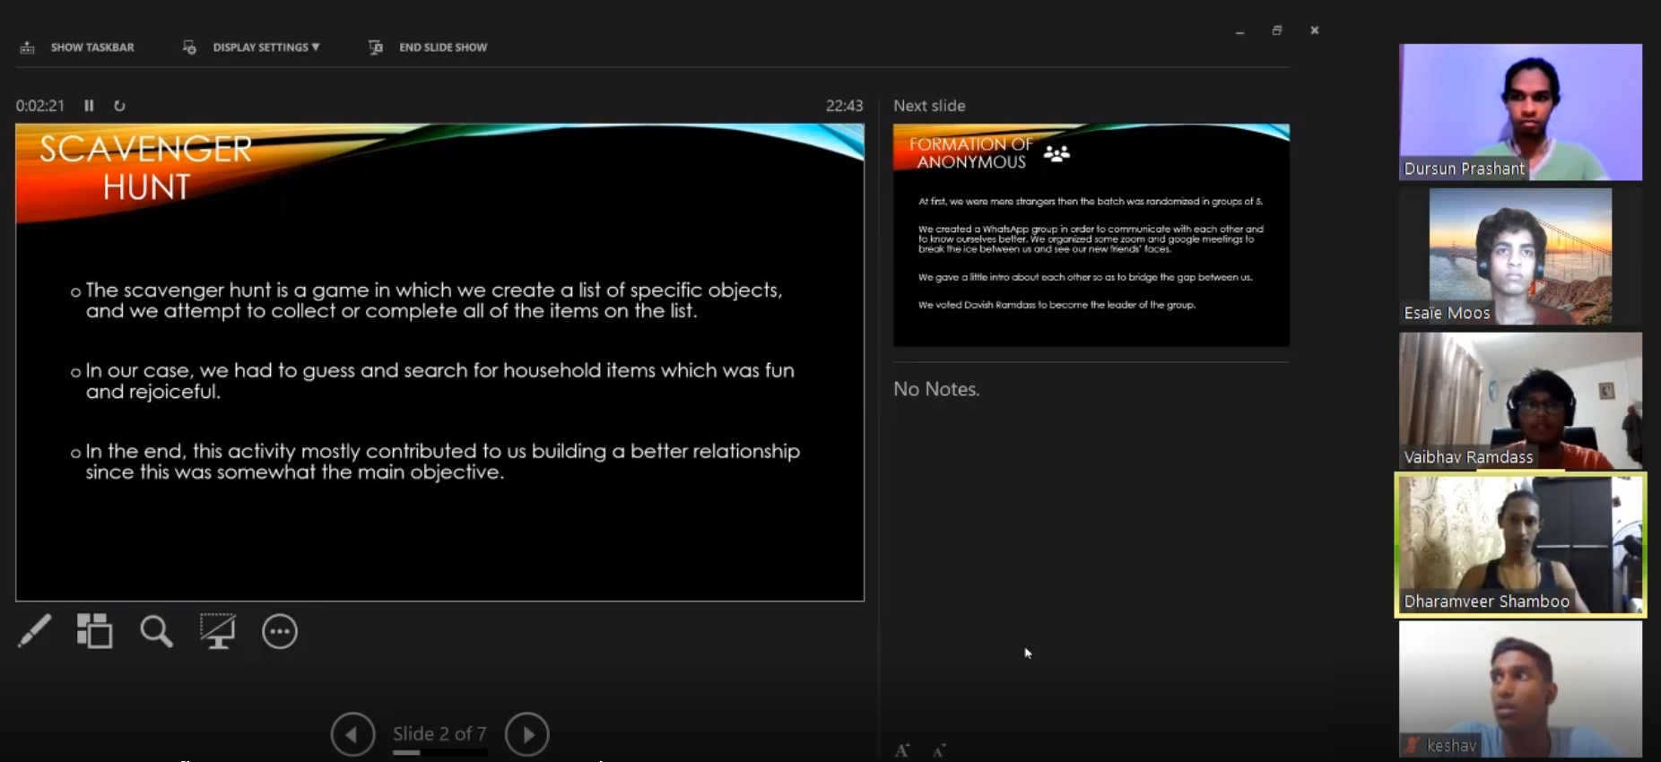
Scavenger Hunt
Started with discussing on the activity we have done earlier which was scavenger hunt while also bridging the gap of team members.

Slide 4
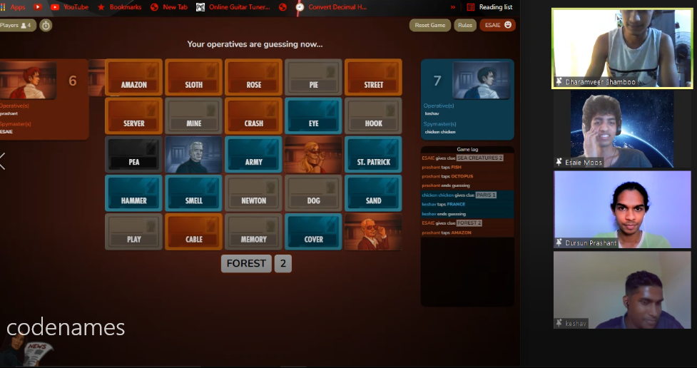
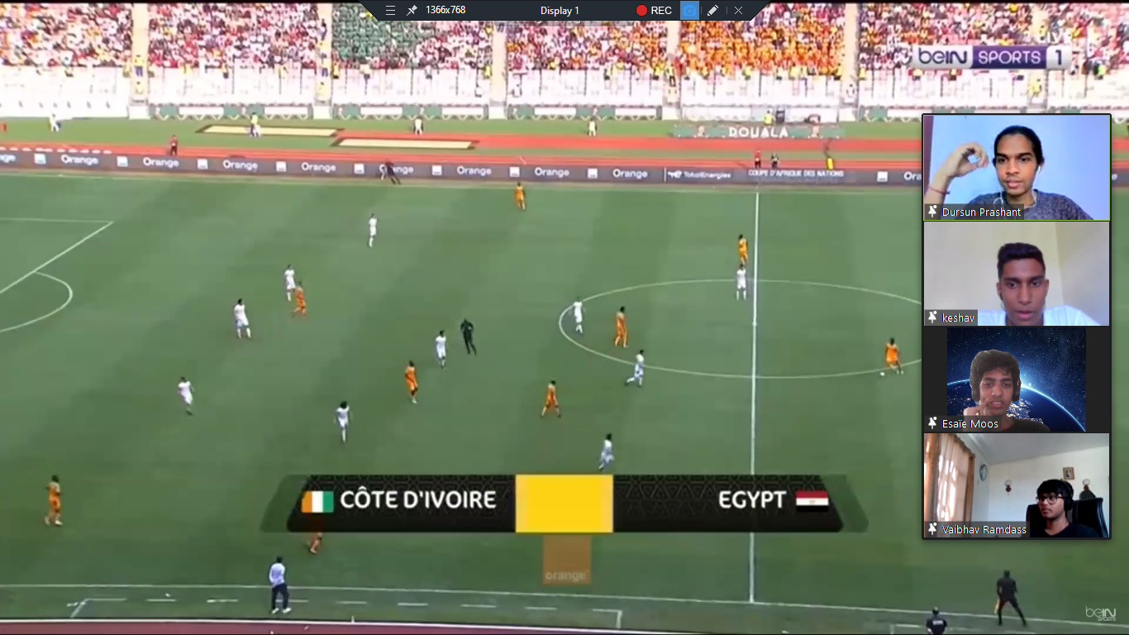
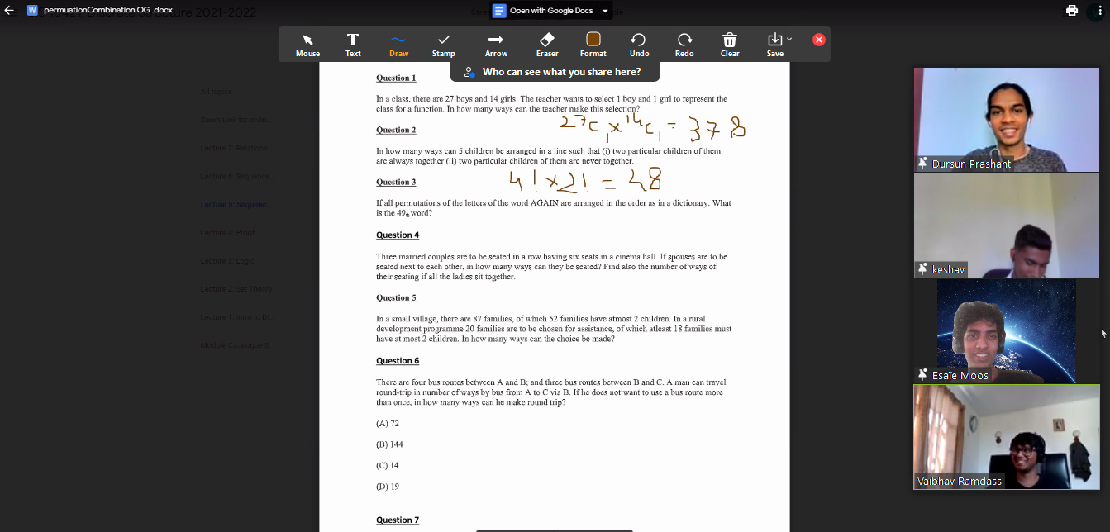
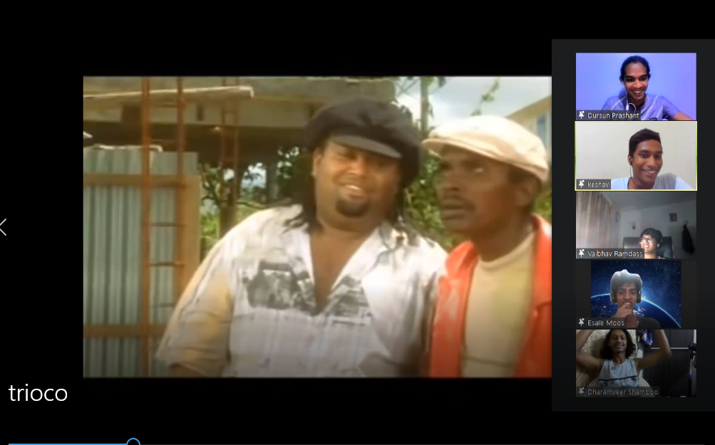
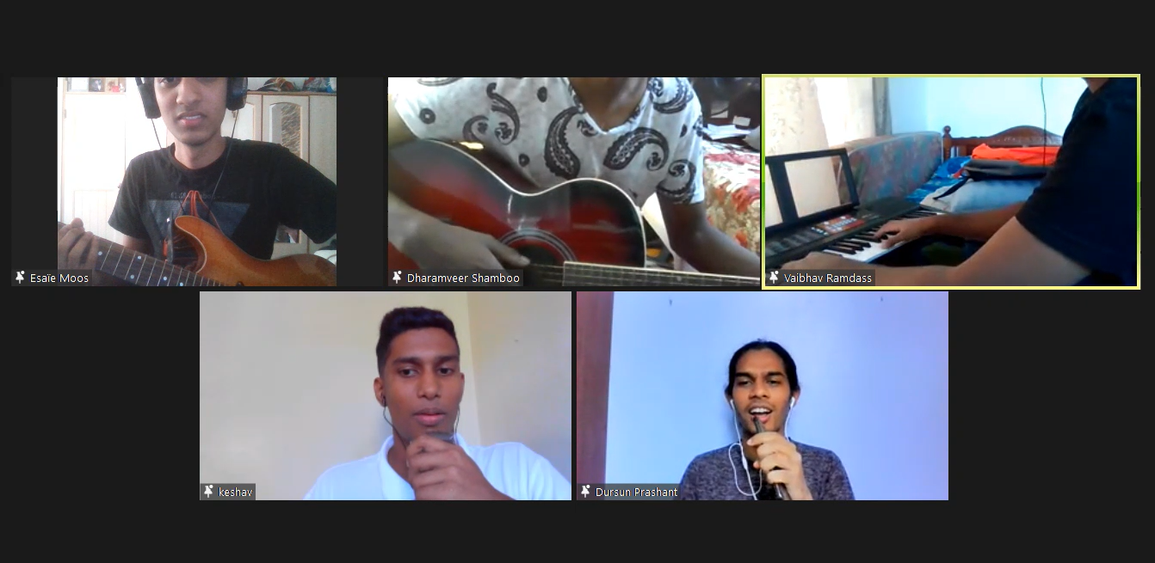
Team Building

Slide 5
Team Building
Play games
Watch football
Work labsheets
Watch movies

Slide 6
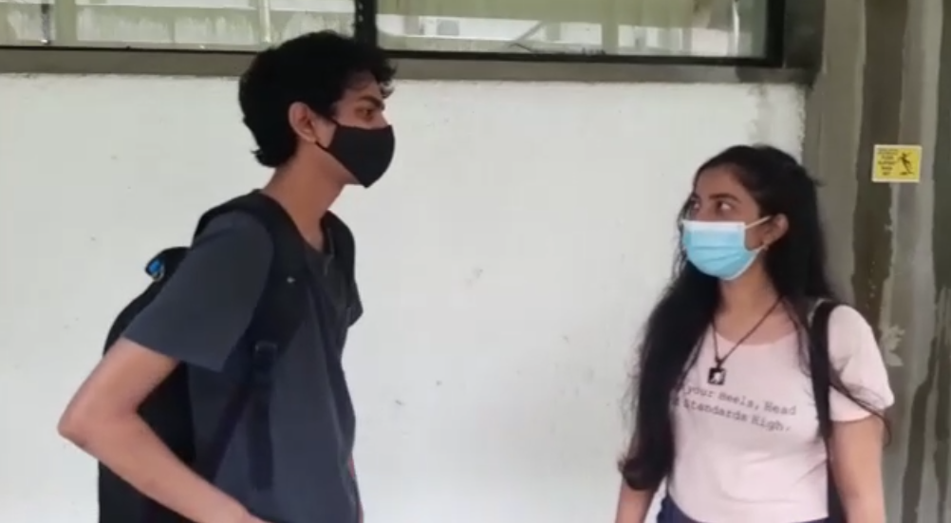
Meeting with Strangers
Had the opportunity to lessen social anxiety by meeting a stranger and had a nice and normal talk.

Slide 7

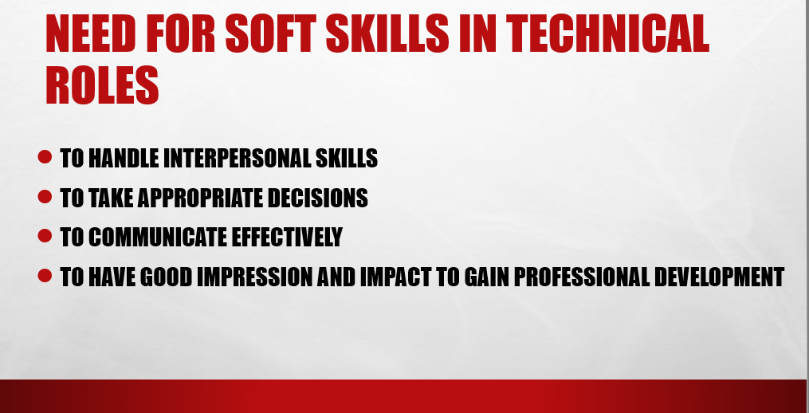
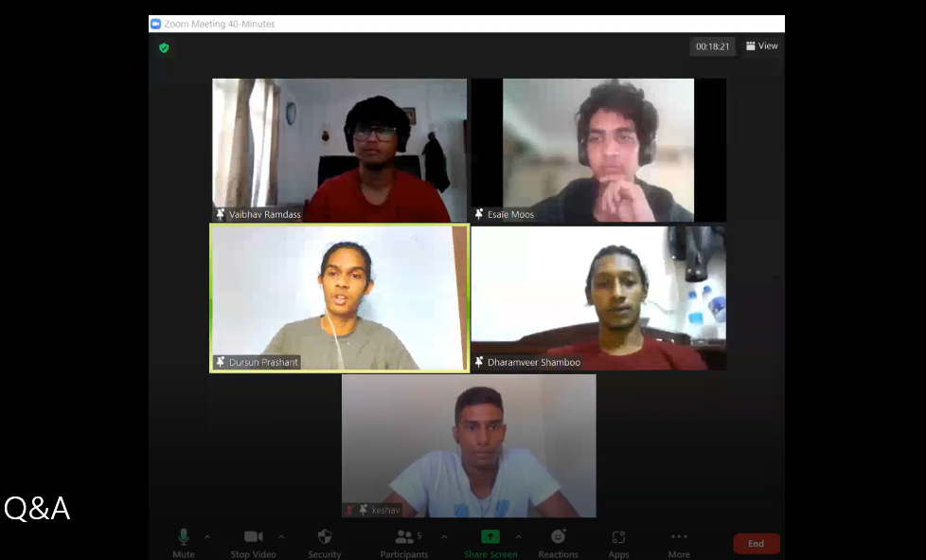
Oral Presentation
Had an oral presentation on soft skills in the technology industry + Q&A

Slide 8
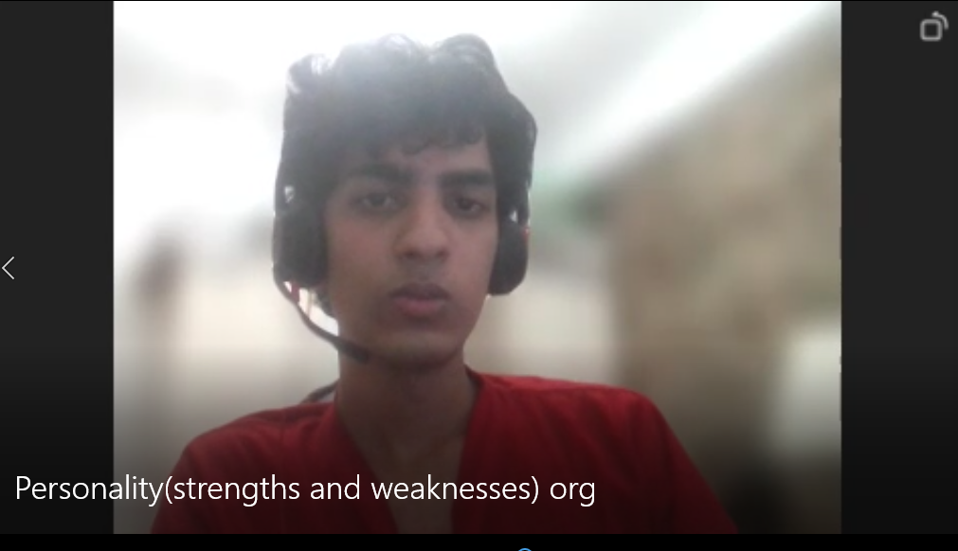
A personal talk
Decided to open up about difficulties facing and sharing strengths and weaknesses

Slide 9
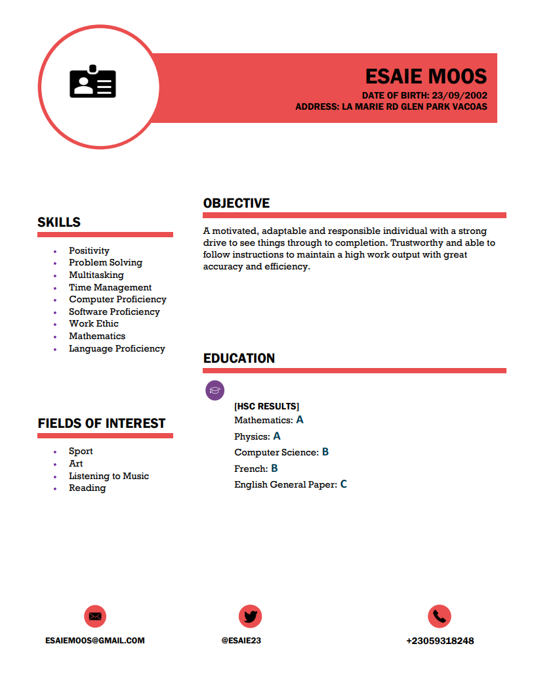
Applying for a job
-Assignment on CV and Business letter.
-Greatly helped on how to write a CV properly which will eventually help us in the future

Slide 10
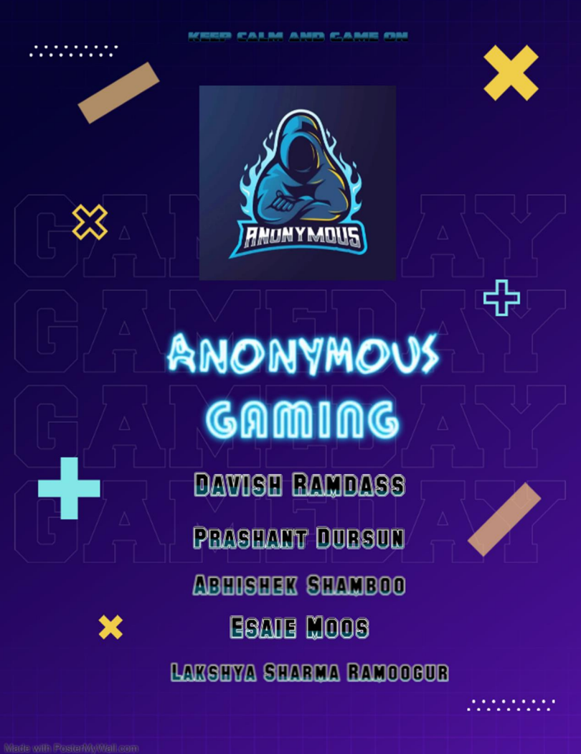
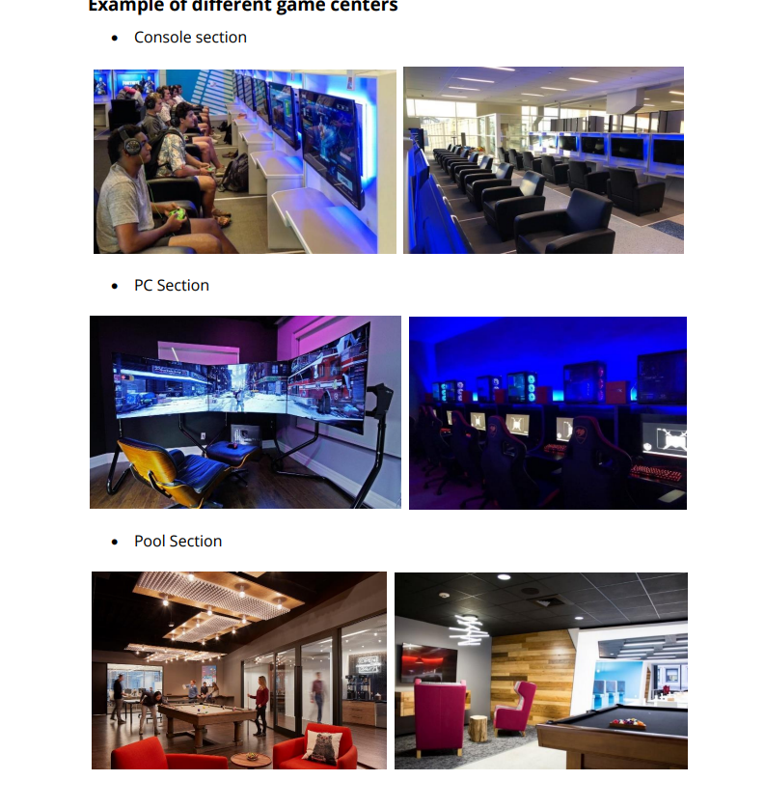
Business Plan
-Assignment on business plan.
-Got the opportunity to discuss a
business idea with the team which
in return broadened our knowledge in the business industry.

Slide 11
Interview
Had an interview face to face where I was applying for a job in the technology industry.
Dress code was formal wear

Slide 12
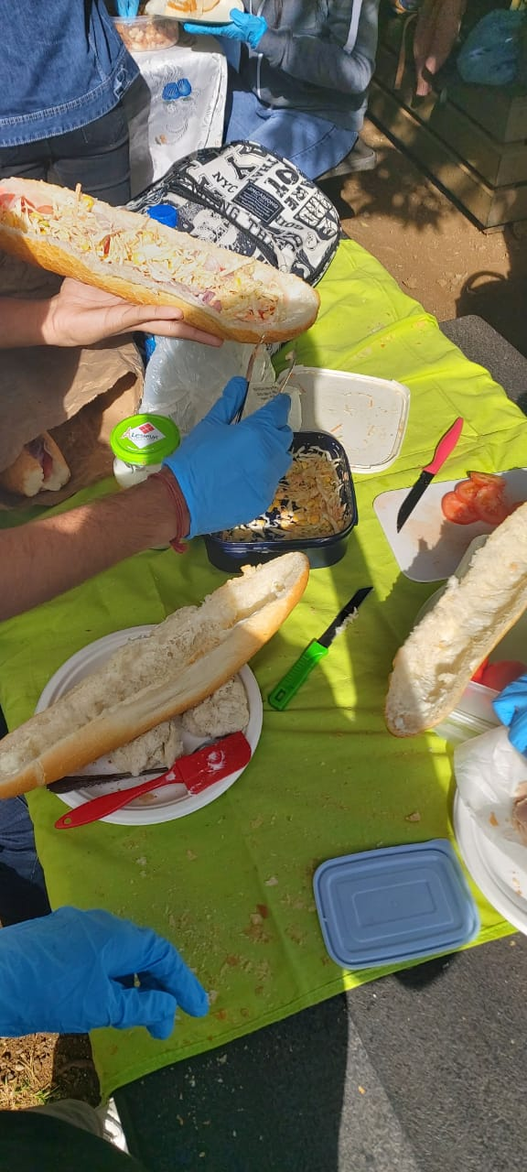
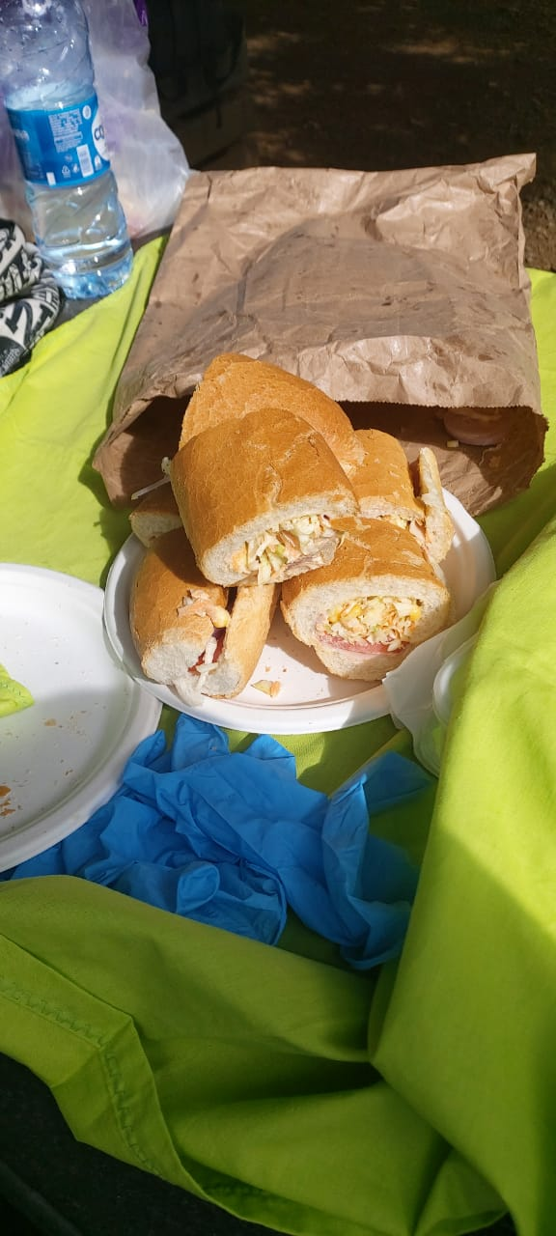
Bring and share
Last week of semester 2, each team members brought food items to prepare a special dish which we then shared with each other.
Nonetheless, had a great time with everyone.

Slide 13
CONCLUSION
In the end, I can confidently say that I am now prepared for what is coming for me next since all these activities that I have partaken in have showed me the life that I wanted. It helped me both mentally, emotionally and physically. I made some new friends which I consider as family and there is nothing better than that.

